Slide 1
RIPv2
Routing Protocols and Concepts – Chapter 7

Slide 2
Objectives
Encounter and describe the limitations of RIPv1’s limitations.
Apply the basic Routing Information Protocol Version 2 (RIPv2) configuration commands and evaluate RIPv2 classless routing updates.
Analyze router output to see RIPv2 support for VLSM and CIDR
Identify RIPv2 verification commands and common RIPv2 issues.
Configure, verify, and troubleshoot RIPv2 in “hands-on” labs

Slide 3
Introduction
Chapter focus
-Difference between RIPv1 & RIPv2
    RIPv1
        -A classful distance vector routing protocol
        -Does not support discontiguous subnets
        -Does not support VLSM
        -Does not send subnet mask in routing update
        -Routing updates are broadcast
    RIPv2
-A classless distance vector routing protocol that is an enhancement of RIPv1’s features.
-Next hop address is included in updates
-Routing updates are multicast
-The use of authentication is an option

Slide 4
Introduction
Similarities between RIPv1 & RIPv2
-Use of timers to prevent routing loops
-Use of split horizon or split horizon with poison reverse
-Use of triggered updates
-Maximum hop count of 15

Slide 5
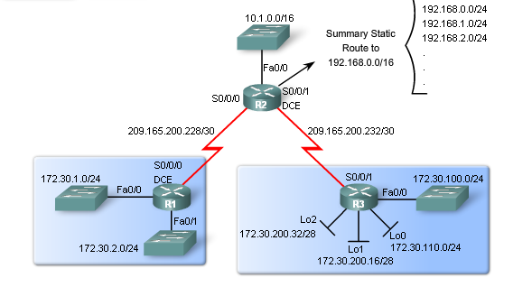
Topology Example

Slide 6
Topology Example
The figure shows the topology and addressing scheme used in this chapter.
This scenario is similar to the routing domain with three routers that was used at the end of Chapter 5, "RIPv1."
Remember that both the R1 and R3 routers have subnets that are part of the 172.30.0.0/16 major classful network (class B).
Also remember that R1 and R3 are connected to R2 using subnets of the 209.165.200.0/24 major classful network (class C).
This topology is discontiguous and will not converge because 172.30.0.0/16 is divided by the 209.165.200.0/24.

Slide 7
Summary Route
The topology shows that R2 has a static summary route to the 192.168.0.0/16 network. The configuration of this summary route will be displayed later in this section.
The concept and configuration of static summary routes was discussed in Chapter 2, "Static Routing." We can inject static route information into routing protocol updates.
This is called redistribution and will also be discussed later in this section.
For now, understand that this summary route will cause problems with RIPv1 because 192.168.0.0/16 is not a major classful address and includes all of the /24 versions of 192.168.0.0/16, as shown in the topology.
Finally, notice that the R1 and R3 routers contain VLSM networks and are sharing address space from the 172.30.0.0/16 major classful network. Next, we will look at the VLSM addressing scheme.

Slide 8
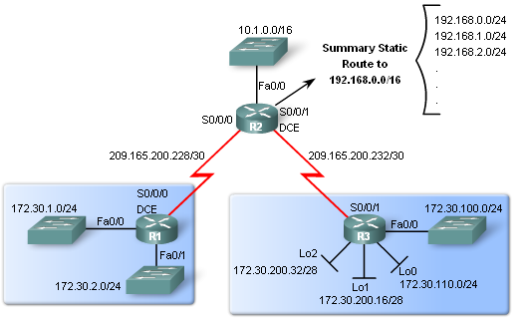
RIPv1 Limitations
Lab Topology
Scenario:
  3 router set up
  Topology is discontiguous
  There exists a static summary route
  Static route information can be injected into routing table updates using redistribution.
  Routers 1 & 3 contain VLSM networks

Slide 9
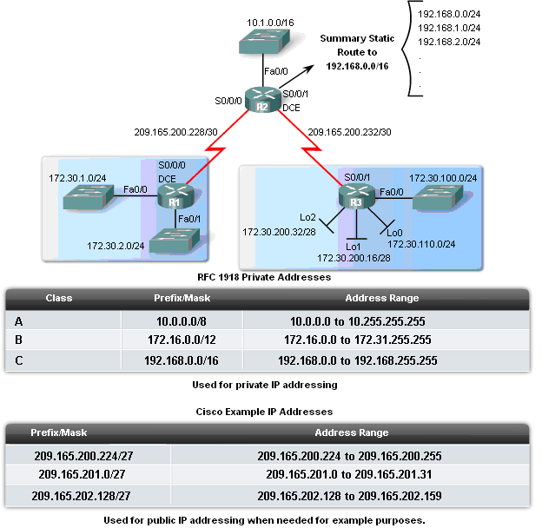
RIPv1 Limitations
Scenario Continued
VLSM
-Recall this is sub netting the subnet
Private IP addresses are on LAN links
Public IP addresses are used on WAN links
Loopback interfaces
-These are virtual interfaces that can be pinged and added to routing table

Slide 10
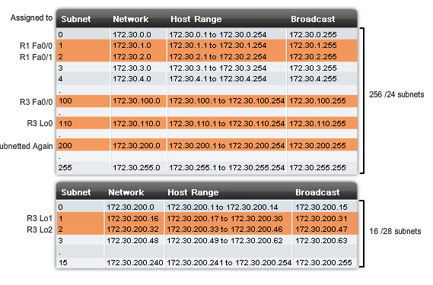
VLSM Addressing Scheme

Slide 11
VLSM
Review the VLSM addressing scheme in the figure.
As shown in the top chart, both R1 and R3 have had the 172.30.0.0/16 network subnetted into /24 subnets.
Four of these /24 subnets are assigned: two to R1 (172.30.1.0/24 and 172.30.2.0/24) and two to R3 (172.30.100.0/24 and 172.30.110.0/24).
In the bottom chart, we have taken the 172.30.200.0/24 subnet and subnetted it again, using the first four bits for subnets and the last four bits for hosts.
The result is a 255.255.255.240 mask or /28. Subnet 1 and Subnet 2 are assigned to R3.
This means that the subnet 172.30.200.0/24 can no longer be used even though the remaining /28 subnets can be used.

Slide 12
Loopback Interfaces
Notice that R3 is using loopback interfaces (Lo0, Lo1, and Lo2).
A loopback interface is a software-only interface that is used to emulate a physical interface.
Like other interfaces, it can be assigned an IP address. Loopback interfaces are also used by other routing protocols, such as OSPF, for different purposes.
In a lab environment, loopback interfaces are useful in creating additional networks without having to add more physical interfaces on the router.
A loopback interface can be pinged and the subnet can be advertised in routing updates. Therefore, loopback interfaces are ideal for simulating multiple networks attached to the same router.

Slide 13
Null Interfaces
Null Interfaces
  This is a virtual interface that does not need to be created or configured
-Traffic sent to a null interface is discarded
-Null interfaces do not send or receive traffic
You can use access control lists to filter undesired traffic. Another way to handle undesired traffic is to send it to the null interface.
The null interface is automatically created by the router, is always up, cannot be deleted, and acts as a data sink.
In other words, the null interface cannot forward or receive traffic.
However, the CLI does allow you to access the null interface.
You can direct traffic to the null interface by specifying the null 0 keywords instead of a next-hop or destination address when configuring routes.

Slide 14
RIPv1 Limitations
Static routes and null interfaces
  null interfaces will serve as the exit interface for static route
  -Example of configuring a static supernet route with a null interface
  -R2(config)#ip route 192.168.0.0 255.255.0.0 Null0

Slide 15
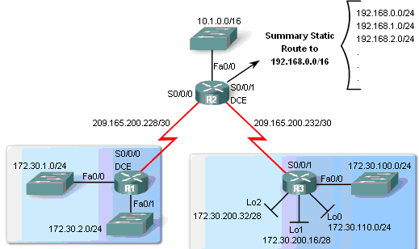
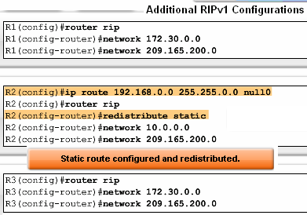
RIPv1 Limitations
Route redistribution
-Redistribution command is way to disseminate a static route from one router to another via a routing protocol
-Example
R2(config-router)#redistribute static

Slide 16
RIPv1 Limitations
Verifying and Testing Connectivity
  Use the following commands:
  show ip interfaces brief
  ping
  traceroute

Slide 17
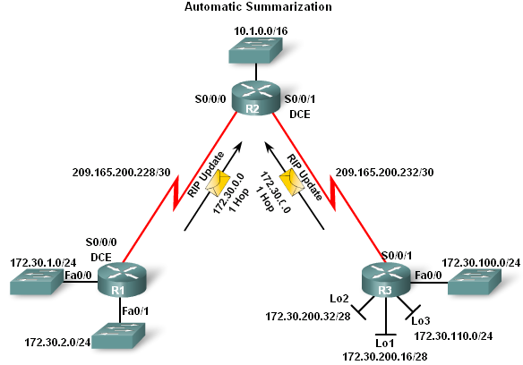
RIPv1 Limitations
RIPv1 – a classful routing protocol
-Subnet mask are not sent in updates
-Summarizes networks at major network boundaries
-if network is discontiguous and RIPv1 configured convergence will not be reached

Slide 18
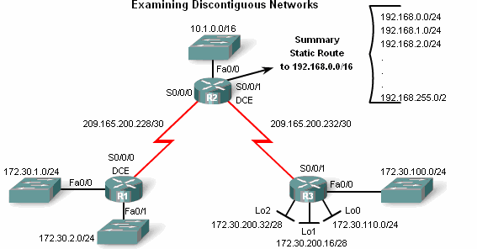
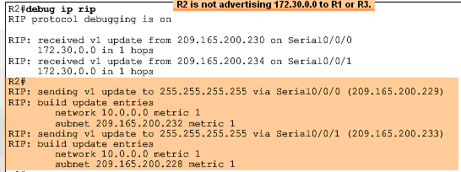
RIPv1 Limitations
  Examining the routing tables
-To examine the contents of routing updates use the
debug ip rip command
-If RIPv1 is configured then
Subnet masks will not be included with the network address

Slide 19
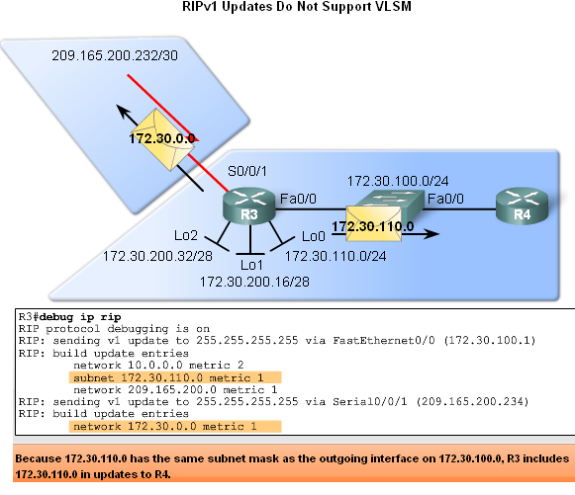
RIPv1 Limitations
RIPv1 does not support VLSM
Reason: RIPv1 does not send subnet mask in routing updates
RIPv1 does summarize routes to the Classful boundary
Or uses the Subnet mask of the outgoing interface to determine which subnets to advertise

Slide 20
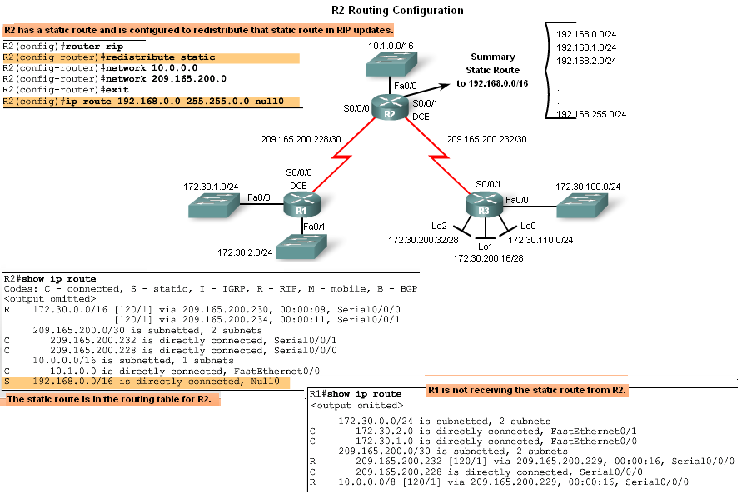
RIPv1 Limitations
No CIDR Support
In the diagram R2 will not include the static route in its update
Reason: Classful routing protocols do not support CIDR routes that are summarized with a smaller mask than the classful subnet mask

Slide 21
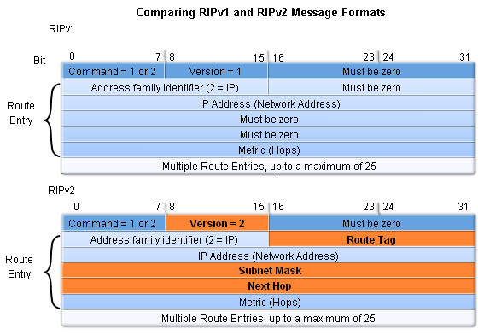
Configuring RIPv2
Comparing RIPv1 & RIPv2 Message Formats
-RIPv2 Message format is similar to RIPv1 but has 2 extensions
      1st extension is the subnet mask field
      2nd extension is the addition of next hop address

Slide 22
RIPv2 Extensions
The first extension in the RIPv2 message format is the subnet mask field that allows a 32 bit mask to be included in the RIP route entry. As a result, the receiving router no longer depends upon the subnet mask of the inbound interface or the classful mask when determining the subnet mask for a route.
The second significant extension to the RIPv2 message format is the addition of the Next Hop address. The Next Hop address is used to identify a better next-hop address - if one exists - than the address of the sending router. If the field is set to all zeros (0.0.0.0), the address of the sending router is the best next-hop address.

Slide 23
Configuring RIPv2
Enabling and Verifying RIPv2
Configuring RIP on a Cisco router
By default it is running RIPv1

Slide 24
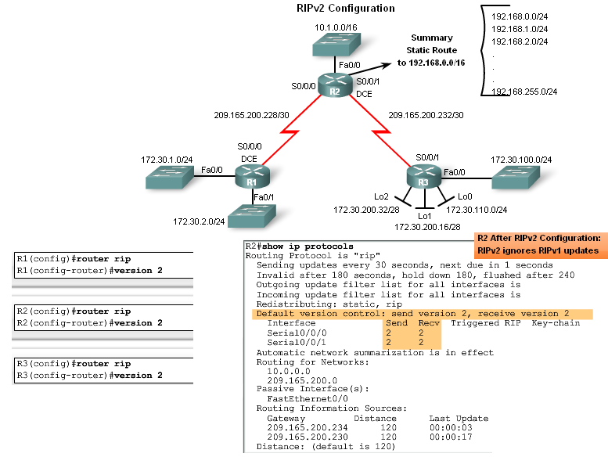
Configuring RIPv2
Configuring RIPv2 on a Cisco router
-Requires using the version 2 command
-RIPv2 ignores RIPv1 updates
To verify RIPv2 is configured use the
show ip protocols command

Slide 25
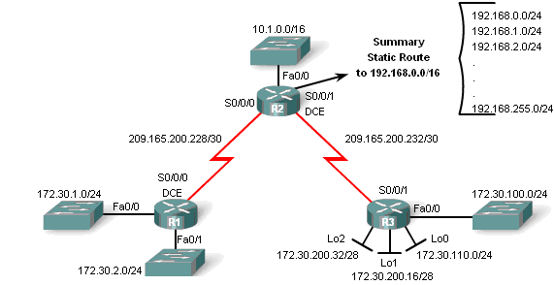
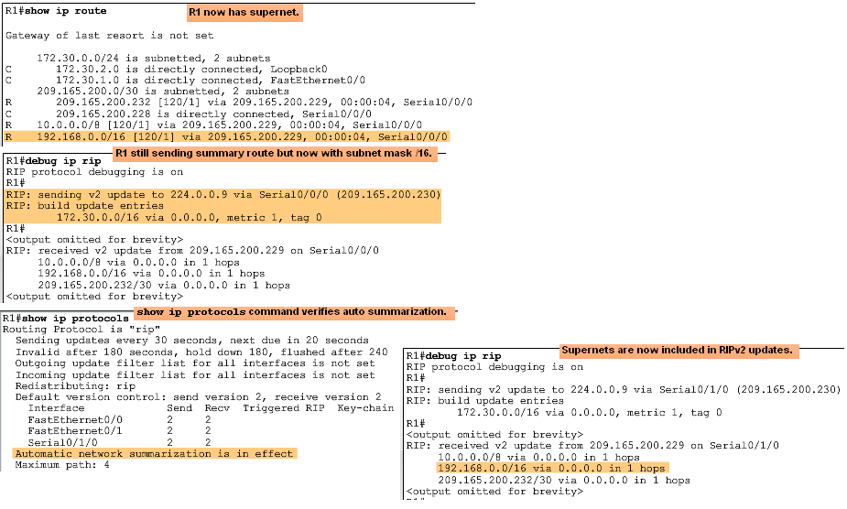
Configuring RIPv2
Auto-Summary & RIPv2
RIPv2 will automatically summarize routes at major network boundaries and can also summarize routes with a subnet mask that is smaller than the classful subnet mask

Slide 26
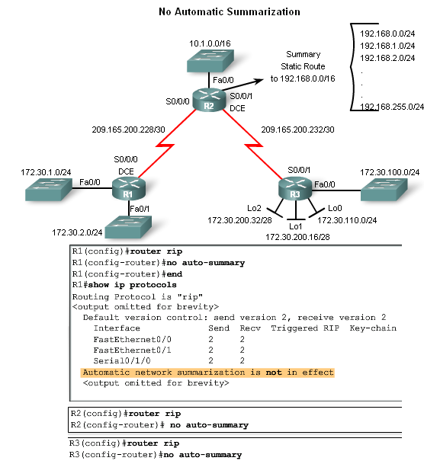
Configuring RIPv2
Disabling Auto-Summary in RIPv2
To disable automatic summarization issue the no auto-summary command

Slide 27
Configuring RIPv2
Verifying RIPv2 Updates
When using RIPv2 with automatic summarization turned off
Each subnet and mask has its own specific entry, along with the exit interface and next-hop address to reach that subnet.
To verify information being sent by RIPv2 use the
debug ip rip command

Slide 28
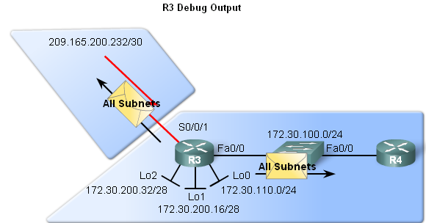
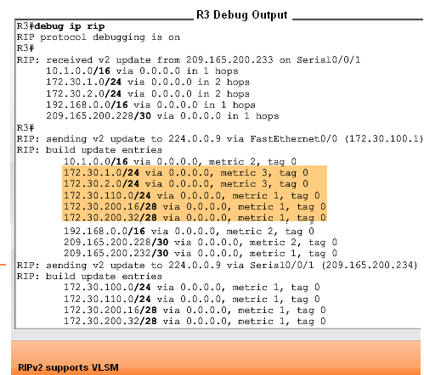
VLSM & CIDR
RIPv2 and VLSM
Networks using a VLSM IP addressing scheme
Use classless routing protocols (i.e. RIPv2) to disseminate network addresses and their subnet masks

Slide 29
VLSM & CIDR
CIDR uses Supernetting
Supernetting is a bunch of contiguous classful networks that is addressed as a single network.

Slide 30
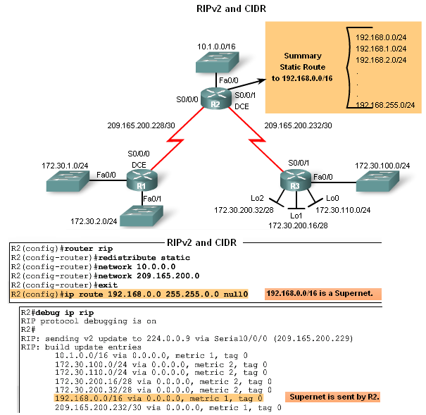
VLSM & CIDR
To verify that supernets are being sent and received use the following commands
-Show ip route
-Debug ip rip

Slide 31
Verifying & Troubleshooting RIPv2
Basic Troubleshooting steps
-Check the status of all links
-Check cabling
-Check IP address & subnet mask configuration
-Remove any unneeded configuration commands
Commands used to verify proper operation of RIPv2
  Show ip interfaces brief
  Show ip protocols
  Debug ip rip
  Show ip route

Slide 32
Verifying & Troubleshooting RIPv2
Common RIPv2 Issues
When trouble shooting RIPv2 examine the following issues:
    Version
Check to make sure you are using version 2
    Network statements
Network statements may be incorrectly typed or missing
    Automatic summarization
If summarized routes are not needed then disable automatic summarization

Slide 33
Verifying & Troubleshooting RIPv2
Reasons why it’s good to authenticate routing information
-Prevent the possibility of accepting invalid routing updates
-Contents of routing updates are encrypted
Types of routing protocols that can use authentication
-RIPv2
-EIGRP
-OSPF
-IS-IS
-BGP

Slide 34
Summary
Routing Protocol | Distance Vector | Classless Routing Protocol | Uses Hold-Down Timers | Use of Split Horizon or Split Horizon w/ Poison Reverse | Max Hop count = 15 | Auto Summary | Support CIDR | Supports VLSM | Uses Authen-tication
RIPv1 | Yes | No | Yes | Yes | Yes | Yes | No | No | No
RIPv2 | Yes | Yes | Yes | Yes | Yes | Yes | Yes | Yes | Yes

